Slide 1
IN THE NAME OF GOD

Slide 2
Surgical treatment of abnormal uterine bleeding
M.Hashemi MD
Assistant professor and head of division of laparoscopy
maryam.hashemi@med.mui.ac.ir
Isfahan university of medical sciences

Slide 3
Endometrial ablation
Endometrial ablation has become an increasingly popular treatment since it is minimally invasive and successful ablation avoids chronic use of medications
In a national study in England from 2003 to 2006, 60 %of all surgical procedures performed for menorrhagia were endometrial ablations

Slide 4
Endometrium must be destroyed or resected to the level of the basalis , which is approximately 4 to 6 mm deep, depending upon the stage of the menstrual cycle
under hysteroscopic visualization, using resectoscopic instruments to ablate or resect endometrium(first generation ablation or standard)
non-resectoscopic ablation device(second generation or global) Including:NovaSure/hot liquid-filled ballon/cryotherapy/Minerva

Slide 7
PATIENT SELECTION
*ovulatory menorrhagia in premenopausal women
*acute AUB in hemodynamically stable women

Slide 8
Contraindications
Pregnancy
Known or suspected complex or atypical endometrial hyperplasia or cancer
Desire to preserve fertility
Active pelvic infection
IUD in place
Previous transmyometrial uterine surgery

Slide 9
relatively contraindicated
postmenopausal
congenital uterine anomalies (eg, bicornuate uterus)
uterine cavity length > 10 to 12 cm
severe myometrial thinning

Slide 10
Mechanism
intrauterine adhesions that may prevent or delay bleeding that is cardinal symptom of endometrial cancer and/or interfere with endometrial sampling .
In addition, histologic evaluation of endometrial samples from women who have undergone ablation may be difficult

Slide 11
Cavity size
Each non-resectoscopic ablation device can accommodate a different minimum (4 to 6 cm) and maximum (10 to 12 cm) uterine cavity size. Ablation may be incomplete in women with a cavity larger than the maximum.
Cavity size is less important for resectoscopic ablation.
Successful improvement of uterine bleeding symptoms has been reported following partial ablation with resectoscopic ablation or resection, but not for non-resectoscopic techniques

Slide 12
Bleeding disorders or anticoagulation
Most methods of endometrial ablation are appropriate for use in such women
Endometrial resection should be avoided in women who have a bleeding disorder or who are taking anticoagulants, and a rollerball ablation or a non-resectoscopic ablation should be considered.
In our practice, we do not stop anticoagulation in patients undergoing endometrial ablation as the risk of bleeding is very low.

Slide 13
PREOPERATIVE EVALUATION
Informed consent
Evaluation
Endometrial sampling to exclude endometrial hyperplasia or cancer
Assessment of the uterus by SIS or office hysteroscopy

Slide 14
COMPLICATIONS
Hemorrhage
Uterine perforation
Hematometra
Hematometra should be suspected in a patient with a history of an endometrial ablation who presents with amenorrhea and cyclic pain, even remote from the procedure
Uterine cavity occlusion. Thus, ablation of the cervix or cervico-uterine junction should be avoided. Complete ablation of the uterine fundus, cornua, and tubal ostia will also help avoid accumulation of blood from active endometrium.
Pelvic infection

Slide 15
Successful rate:75-83% which one????
Non-resectoscopic OR resectoscopic ablation
resectoscopic ablation
if shape or size of uterine cavity will not accommodate a non-resectoscopic device
if a concomitant procedure such as submucous fibroid resection is planned
if patient has had multiple cesarean deliveries to avoid ablating over hysterotomy scar

Slide 16
Non-resectoscopic endometrial ablation is performed in most cases
Resectoscopic ablation is a reasonable option for surgeons with the required hysteroscopic skills

Slide 17
Improvement in bleeding symptoms
Women may experience irregular bleeding following endometrial ablation, so the success of the procedure cannot be determined until 8 to 12 weeks postoperatively.
Most women with successful ablation will have a reduction in uterine blood flow, but not amenorrhea.

Slide 18
Patient satisfaction
high for both types of ablation at one year (91 versus 88 percent, OR 1.2, 95% CI 0.9-1.7) and two to five years (93 versus 87 percent, OR 1.4, 95% CI 0.6-3.5)
Women who are less than 45 yr old at time of endometrial ablation appear to be at a higher risk of treatment failure than older women.

Slide 19
Endometrial ablation versus other treatments
Medical therapy
Mirena IUD
Hysterectomy
we offer endometrial ablation as an alternative to hysterectomy

Slide 20
FOLLOW-UP
Routine postoperative care
Light vaginal bleeding or pink-tinged discharge is often present for 2 to 3 days
Uterine cramping may persist for 24 to 72 hours
Most women can resume normal activities in 1 to 3 days

Slide 22
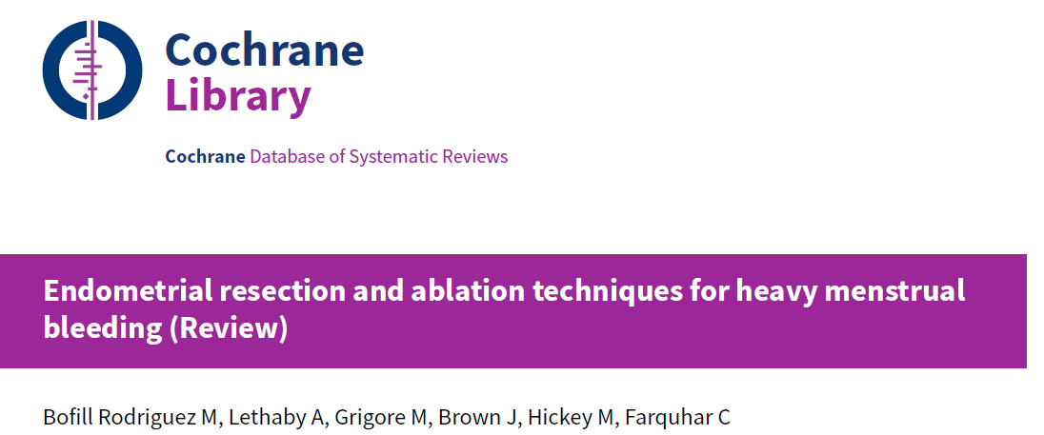

Slide 24
Uterine myoma

Slide 25
For patients with HMB, the first step is determining if there is a submucosal fibroid
Submucosal fibroids amenable to hysteroscopic resection include (FIGO) type 0, type 1, or type 2
Initial hysteroscopic myomectomy is successful in approximately 85 to 95 % of procedures
●Type 0 – completely within the endometrial cavity ●Type I – extend less than 50 percent into the myometrium ●Type II – extend 50 percent or more within the myometrium

Slide 27
Two-step procedures
occasionally necessary for fibroids that are multiple, large, broad-based, or penetrate deeply within the myometrium .
The most common reason for this is that the initial procedure was halted when the maximal fluid absorption was reached.
Such patients should be seen for a follow-up visit 2 to 4 months after the initial procedure to assess whether fibroid-related symptoms persist

Slide 29
Uterine polyps

Slide 30
IMB is most frequent symptom in premenopausal women with endometrial polyps
PMB is another common presentation
Polypectomy under hysteroscopic guidance is choice treatment

Slide 31
UAE

Slide 32
Ideal candidates for UAE include women with all of the following characteristics :
●HMB or dysmenorrhea caused by intramural fibroids
●Premenopausal
●No desire for future pregnancy
satisfaction, and quality of life can be achieved for up to 10 years after treatment

Slide 33
Need for subsequent treatment
Subsequent hysterectomy for failure or recurrence of symptoms after UAE was reported to be 27 percent (51 of 187) at five years in a meta-analysis of four randomized trials

Slide 34
Isthmocele OR Ceasrean Scar Defect OR Uteroperitoneal Fistula OR Niche

Slide 40
Thanks for your attention

